Slide 1
Indian Student Association -NWMSU
Team - 04

Slide 2

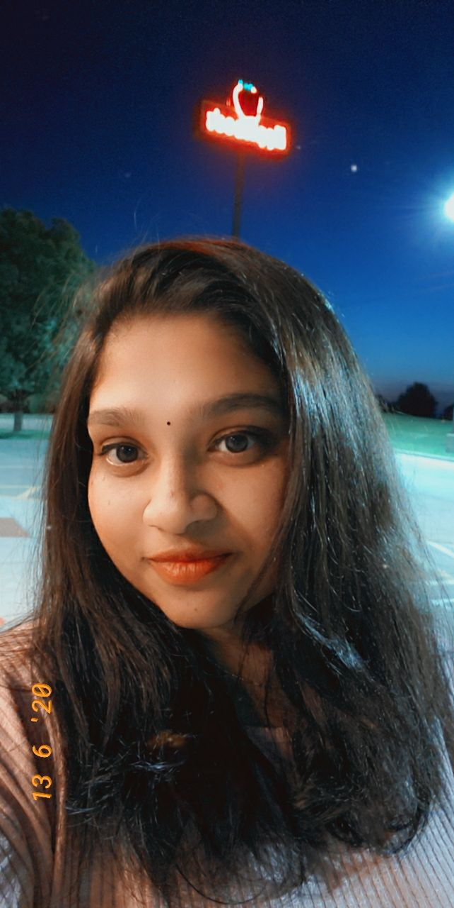

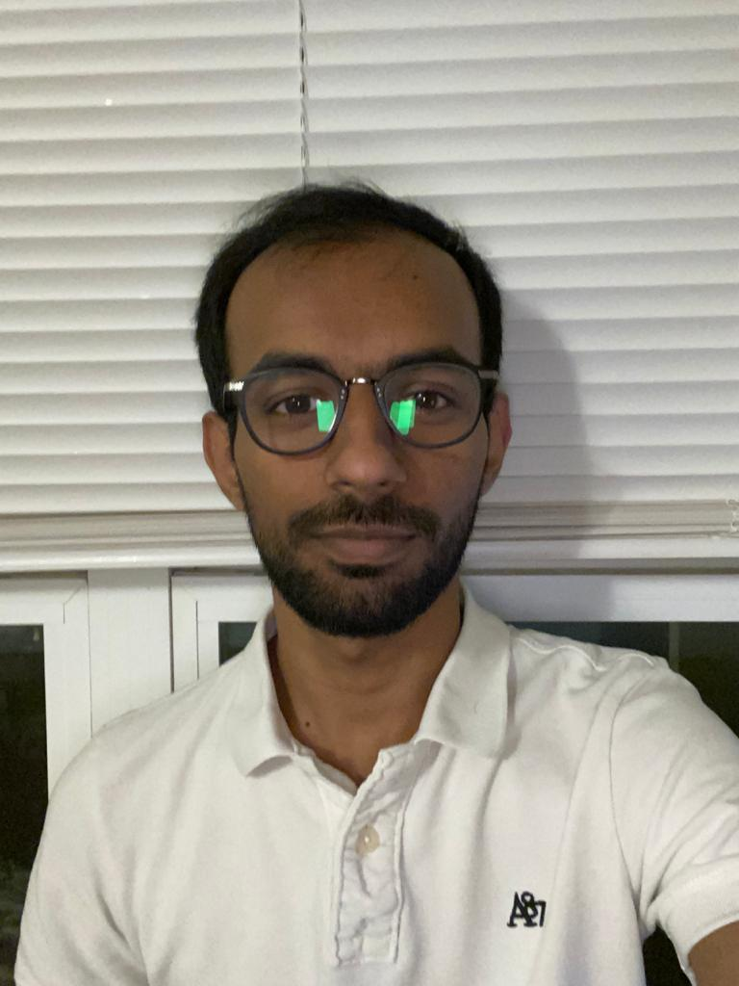
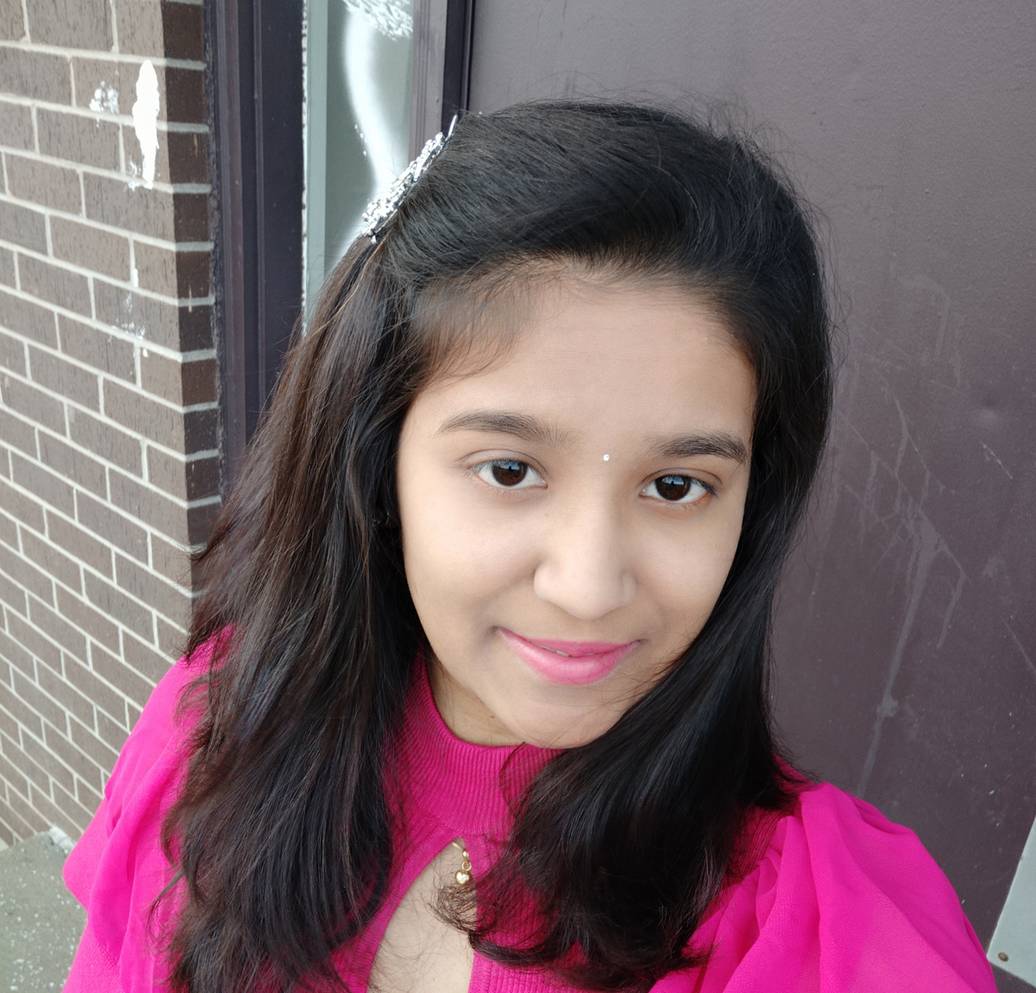

The Team
Dheeraj
Sai Jyothsna
Jeevan Reddy
Bharat Reddy
Bhavya Deepthi
Mahalakshmi

Slide 3
Outline
About the project
Problem statement
Solution
Project Features
Project design
Software requirements
Hardware requirements
Summary

Slide 4
About the project
Indian Student association – NWMSU, is a web-based project which is targeted on the Indian community that attends Northwest Missouri State University.
This project is only being developed as a web application as of now and may be created as a mobile app in the near future.

Slide 5
Problem statement
No common platform to:
Respond to queries
Provide facilities to Indian students
Notify important info
Manage membership
Differentiate between guest, student, and team.

Slide 6
Solution
Our application lets students to:
Request pickup, accommodation
Post queries online
Chat with the team, etc.
Our application lets ISA Team to:
Respond to student queries
Manage memberships
Manage events, etc.

Slide 7
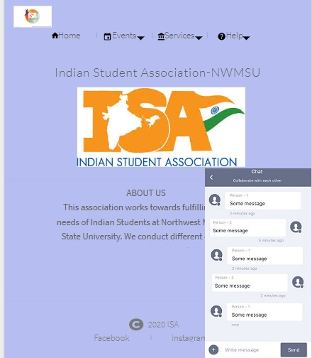
Launch Screen
Application’s home screen: This would be the default screen when a user access the application.
Navigation pane will be used for navigating through the application.

Slide 8
Pre login functionalities

Slide 9
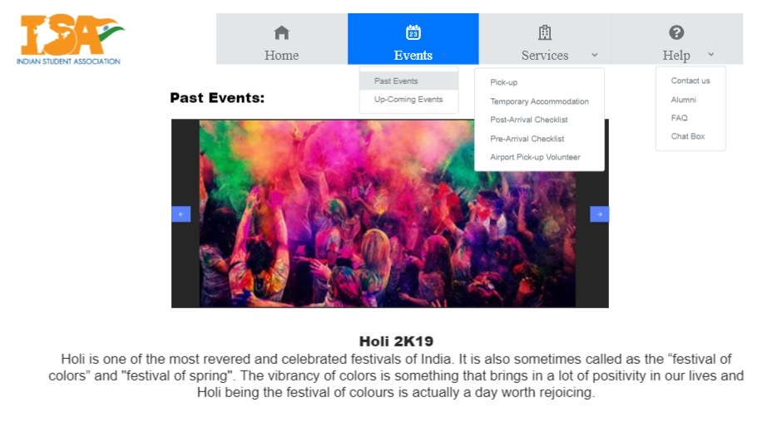
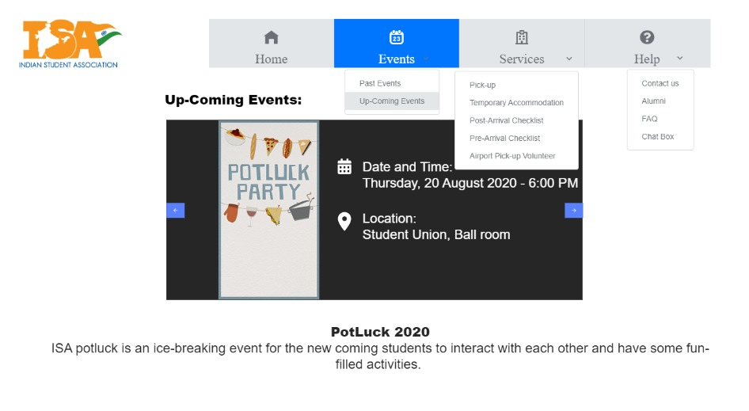
Events
Past events will include data about events successfully hosted by team ISA.
Upcoming events will include data about events about to be hosted by team ISA.

Slide 10
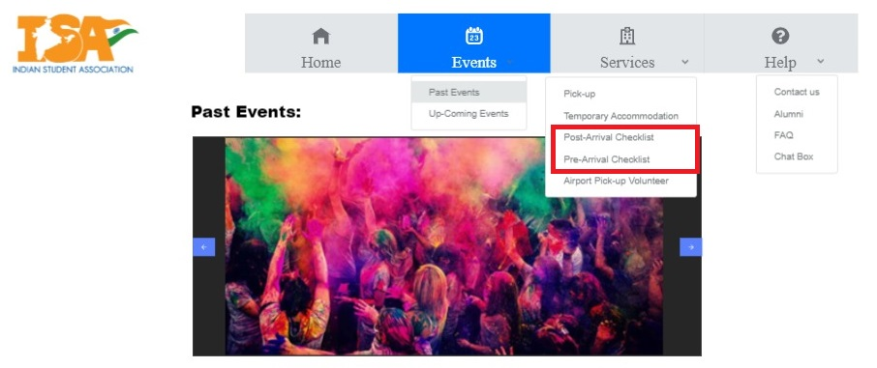
Services
Pre arrival checklist are the tasks to be completed prior to arrival.
Post arrival checklist are the tasks to be completed post arrival.

Slide 11
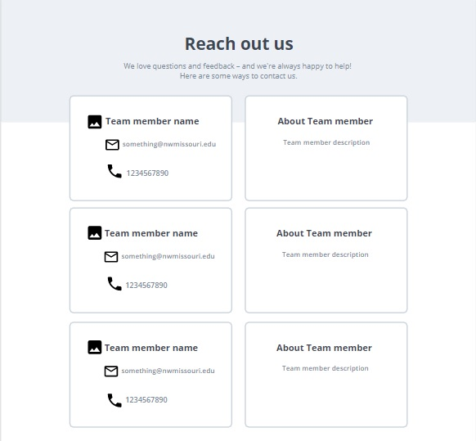
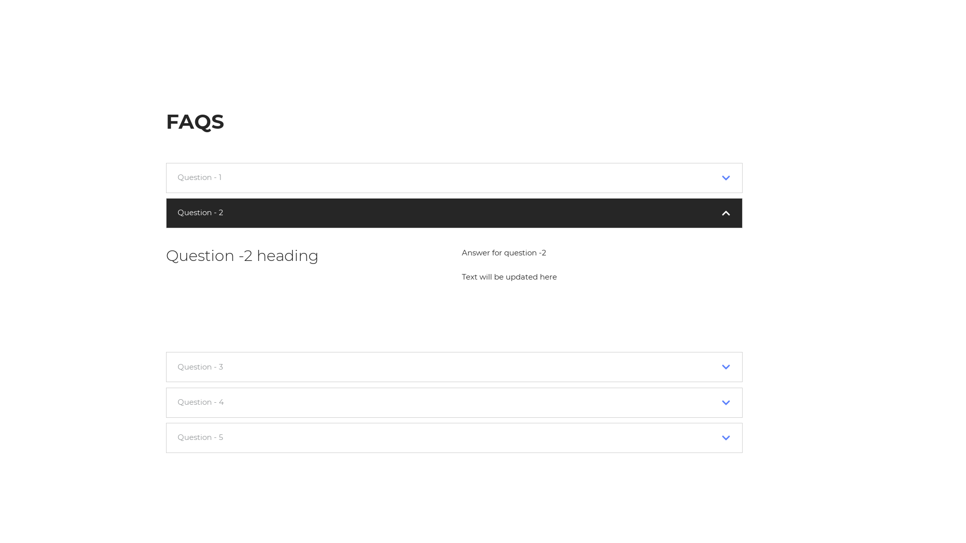
Help
Contact us, helps the users with contact info of the team.
Alumni page helps the users with contact info of the earlier team.
FAQ is used to answer common questions.

Slide 12
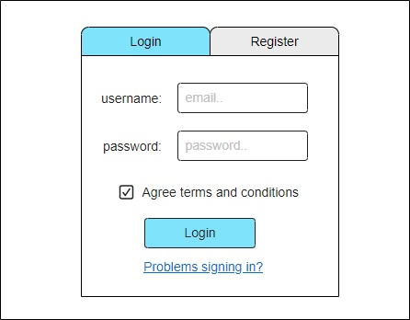
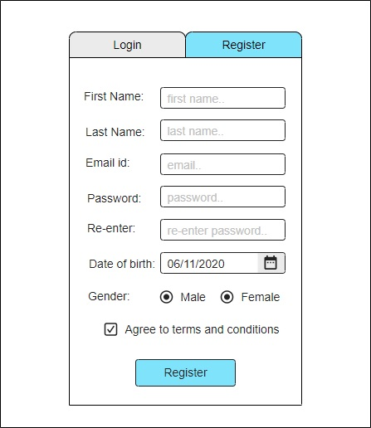
Login/ Signup
Login, lets a user to login to the application.
Sign-up, lets the users to register with the application.

Slide 13
Post login functionalities

Slide 14
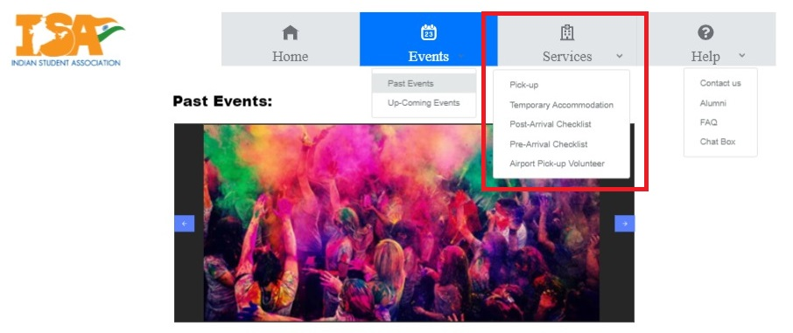
Services
Become a member
Request pickup
Request Temporary accommodation
Pre & Post arrival checklist
Volunteer services

Slide 15
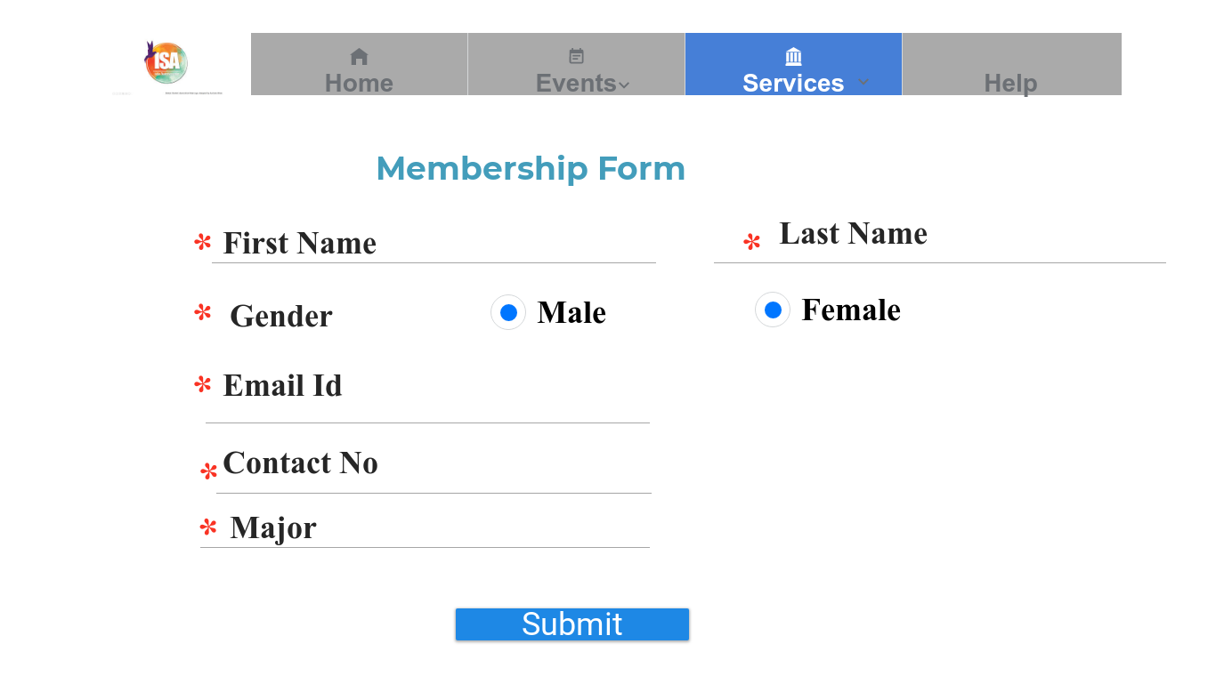
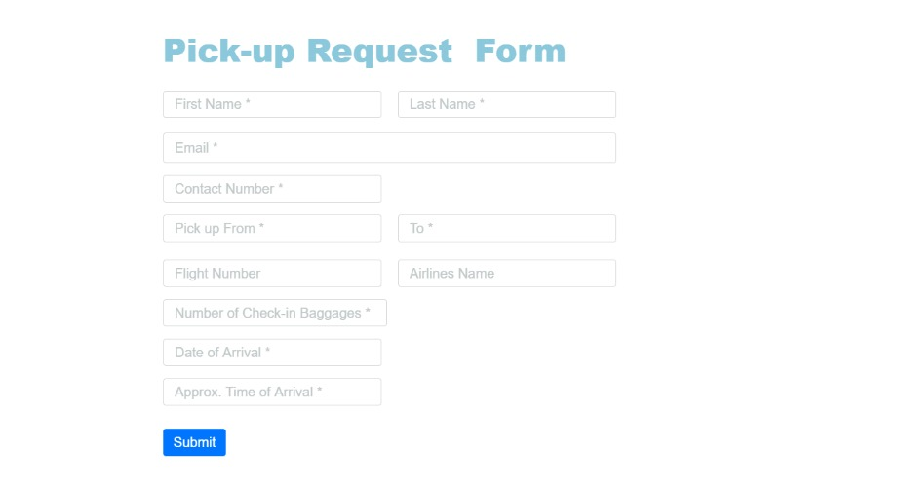
Services
Membership form will be used to request an ISA membership
Pickup form will be used to request an airport/ any other car pooling request.

Slide 16
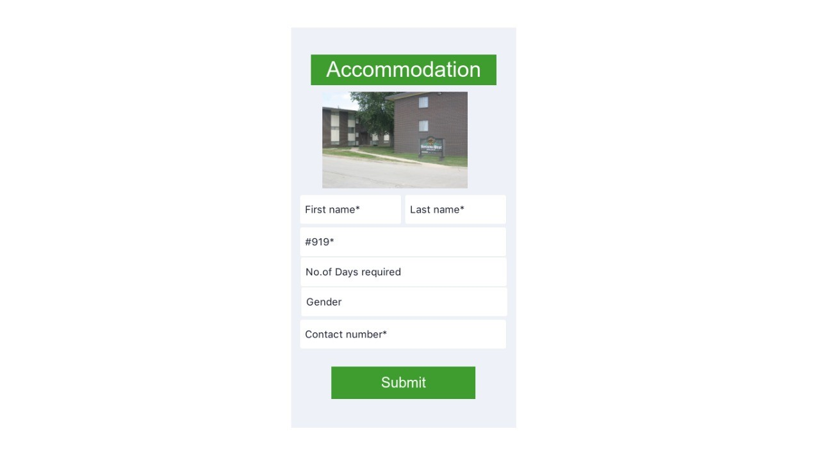
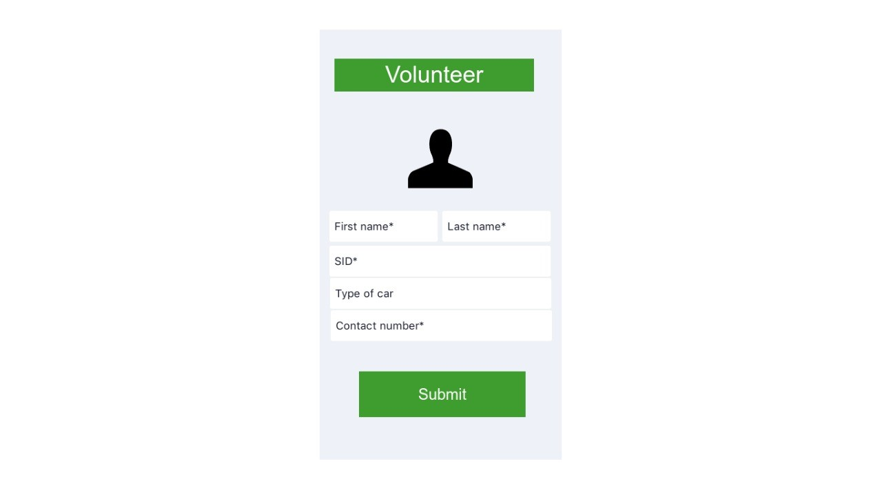
Services
Temporary Accommodation form will be used for requesting a temporary accommodation.
Volunteer form is for volunteers that would want to help ISA team as per their interest.

Slide 17
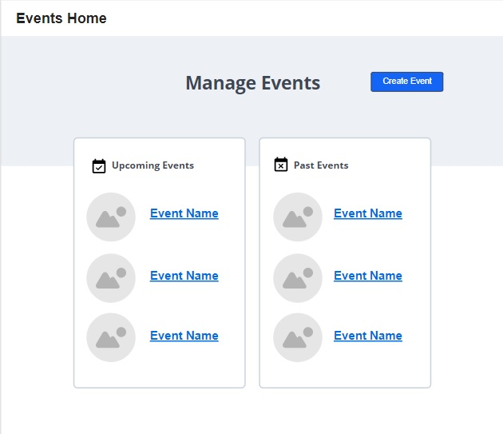
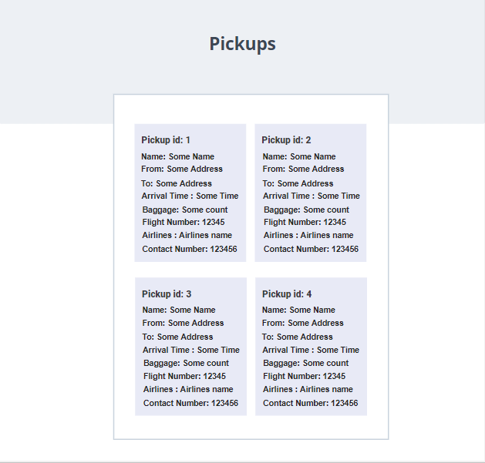
Admin features
An admin will be able to manage events
Admins will be able to view student requests
Admins can edit the help page.
Admin will be able to perform CRUD operations on forum page.

Slide 18
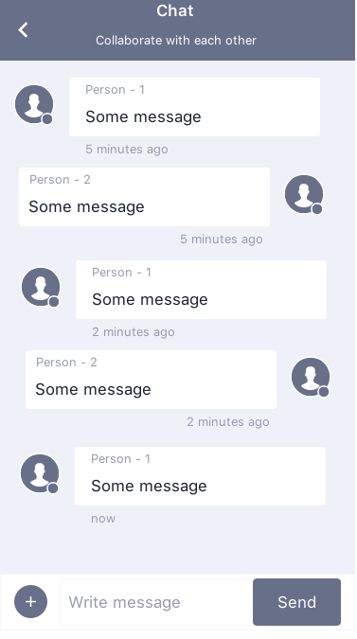
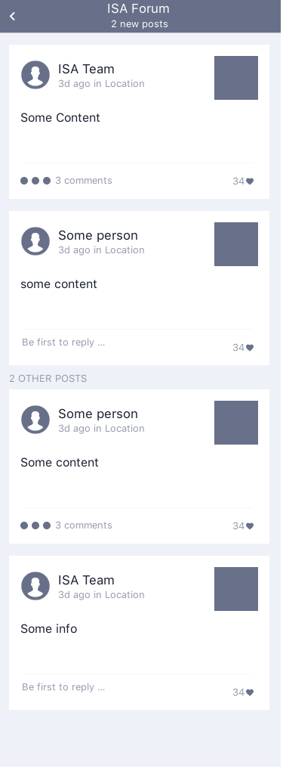
Other features
Chat box is a 24/7 feature to send messages to team ISA
Forum page will be used to add posts on some topic for better reach.
Notifications will be sent to users over email.

Slide 19
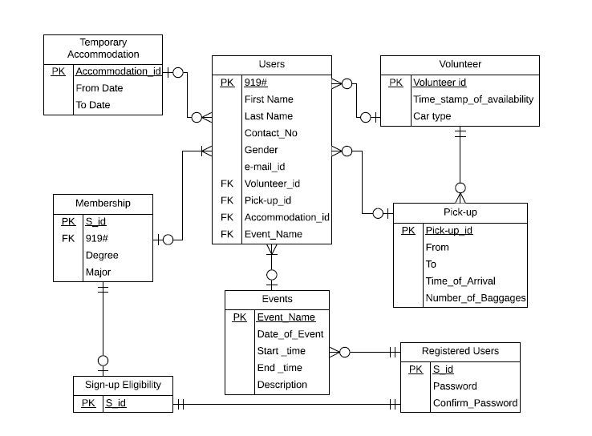
Project Design
Users entity
Volunteer entity
Pick-up entity
Events entity
Registered users entity
Sign-up entity
Membership entity
Temporary accommodation entity

Slide 20
Software Requirements
Front-end : React
Back-end : Node.js
IDE: Visual studio code
Database: Mongo DB

Slide 21
Hardware Requirements
Computers/ Laptops
Internet connection
Server

Slide 22
Summary
Our main intent of creating this project is to help the ISA team and the Indian community studying at Northwest.
We are sure this project helps Team ISA in better managing the organization.

Slide 23
Questions?
Dheeraj
Sai Jyothsna
Jeevan Reddy
Bharat Reddy
Bhavya Deepthi
Mahalakshmi

Slide 24
Thank You..

